Slide 1

BUSINESS COMMUNICATION
PCSE

Slide 2



INTERVIEW
The word ‘interview’ means ‘view between’ or ‘sight between’. It suggests a meeting between two persons for the purpose of getting a view of each other, or for knowing each other or we can say that it is the interaction between interviewer and interviewee.
An interview is a means of two-way communication.
➲ What is the purpose of an interview?
The interviewer will certainly be looking to find out whether you have the potential to do the job effectively and make a useful contribution to the department and the organization.

Slide 3


INTERVIEW
TYPES OF INTERVIEWS AND TIPS FOR EACH TYPE
▪ Phone/Screening Interview – Preliminary, brief interview to determine if the candidate should move forward in the process.
o As with every interview, make sure you are enthusiastic and discuss how your skills match the needs of the employer.
o Make sure to keep a copy of your resume close along with notes on the company and your calendar.
o Determine a location with little distractions and background noise ahead of time. Make sure you have good cell service.

Slide 4
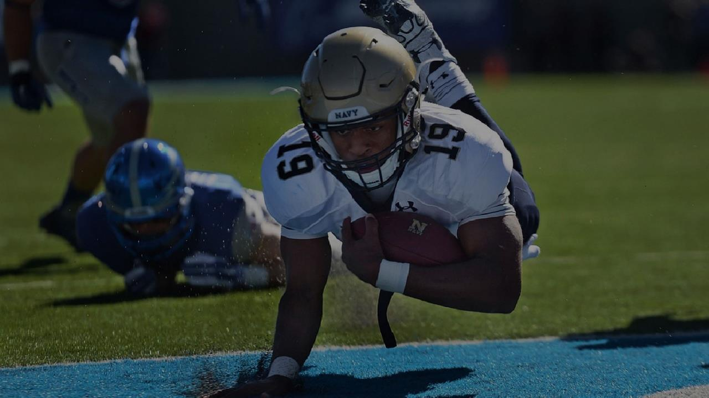



INTERVIEW
▪ In Person Interview - One or more employer representatives will interview the candidate. May be multiple interviews or all day.
o Can include either traditional interview questions or behavioral interview questions.
▪ Group Interview - Takes place with other candidates seeking the same job, predicts how well the candidates interact with others.
o Try to find a good balance between getting your points across and dominating the conversation.
o Practice a two minute introduction that summarizes your education, skills, experience, and related career goals
▪ Case Interview - Includes case questions about hypothetical situations. Used to test your analytical and problem-solving ability.
o Be sure to explain your thinking process in detail to give them a good idea of the steps you take to solve a problem.

Slide 5
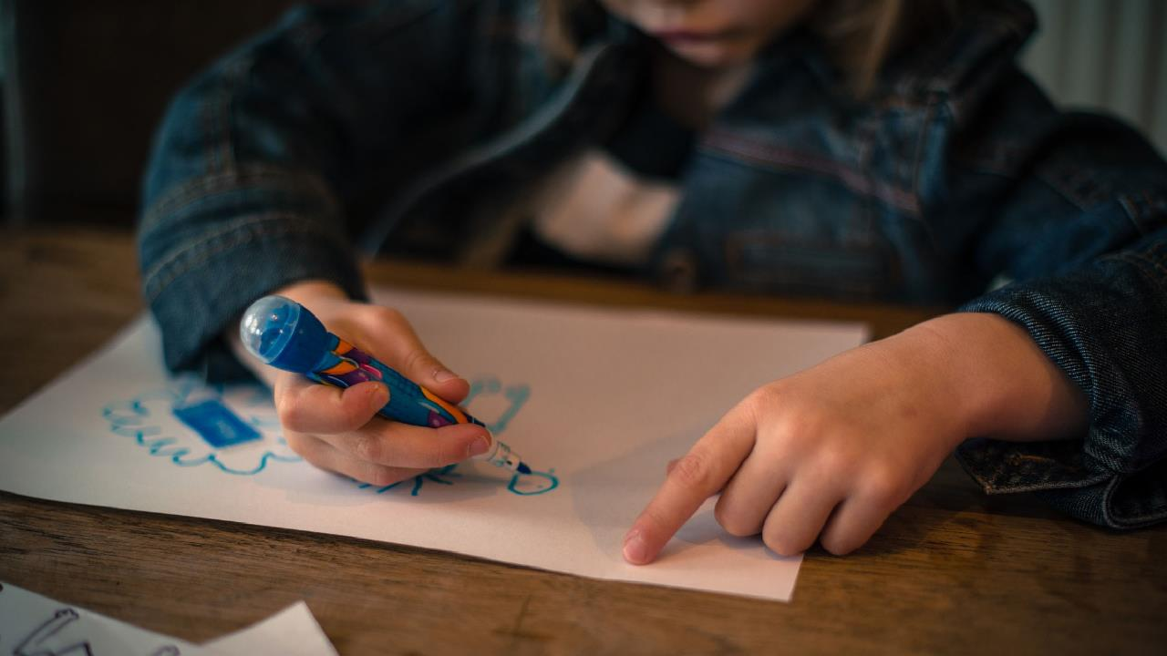



INTERVIEW
▪ Panel Interview - Two or more people will interview you to get different opinions. Can be a very intimidating interview format.
o Be careful not to ignore anyone on the panel. Make eye contact with each person while answering a question.
o When asking questions, make sure they are directed at the group rather than a specific person.
▪ Videoconferencing or Internet Interview - Usually take place over Skype or other videoconferencing services.
o Dress professionally from head to toe and make sure that your background is not distracting (e.g., white or neutral wall)
▪ Pre-recorded Interview - Usually no direct interaction with a person. Given set of questions and asked to record answers.
o Don’t sound too robotic, rehearsed or rushed. Consider attire and background.

Slide 6


INTERVIEW
▪ Stress Interview - Designed to see how you react under pressure. Used in fast-paced positions where quick decisions are needed.
o Focus on the way you solve the problem, not the “right” answer. A typical question is designed to induce stress and can appear very aggressive: “Was the stress of your last job too much for you to handle?”

Slide 7



INTERVIEW
TYPES OF INTERVIEW QUESTIONS AND COMMON EXAMPLES : Traditional Interview
Below are common interview questions with a tip on how to answer the most common ones. Employers usually use your resume to guide their questions. Always have the job description in mind and consider ways to match your skills
✓ Tell me about yourself.
o Tip: Summarize your skills and why you are interviewing today.
✓ Why did you choose the career you’re pursuing?
o Tip: Share what excites you about this field and how you will be successful.
✓ What do you consider your strengths?
o Tip: Describe skills that match the job description and will make you an asset.

Slide 8
INTERVIEW
QUESTIONS TO ASK DURING THE INTERVIEW
Usually near the end of the interview, the employer will ask what questions you have for them. Your goal here is to ask questions that will help you determine if this position and organization is the right place for you.
Do not ask any questions that could be easily answered by looking at their website!
✓ What are the challenges facing this company?
✓ What type of growth do you see for the organization in the next five years?
✓ What social issues does your company support?
✓ How does your organization define and promote diversity?
✓ Is this organization taking actionable steps to ensure an increase in diverse representation across all levels and titles? If so, what are those steps?
✓ How does the company promote professional growth?
✓ How would you describe the organization’s culture?

Slide 9



INTERVIEW
Before the Interview
Research the Company - A company's website is an excellent place to begin. It usually gives you information on whether it is international or domestic, what its revenues are, how many locations it has, and the nature of its major products
Practice interviews - Write down a list of possible questions that you think may be asked, then have a friend act as an interviewer and direct them to you in a practice interview situation. Don't stop until you feel comfortable answering each question.
Dress Professionally - In today's environment, wearing a suit isn't always necessary. Contact the HR Manager of the company or your recruiter, and find out what the dress code is for the company at which you are going to interview.
Arrival - Try to arrive at the interview location a little early. This gives you time to determine where you need to go, and will give Page 2 of 5 you a few minutes to collect your thoughts. DO NOT arrive late. Nothing destroys your chance at impressing an employer more than arriving late and offering no explanation.

Slide 10
INTERVIEW
During the Interview
First impressions - First impressions take only thirty seconds. Establishing rapport, direct and sustained eye contact, a firm handshake, a warm smile, good posture, and introducing yourself in a confident manner are important ingredients. Greet the interviewer with a firm handshake, whether it is a woman or a man. (No one likes a weak handshake.) Always maintain eye contact while shaking hands.
Smile - A smile denotes confidence in a candidate. Try to smile often. Also, don't be afraid to use some hand animation while answering questions.
Body Language - Use good posture, and look the interviewer right in the eye. Sit up straight.
Speak Clearly - Don't mumble. It portrays a lack of confidence. Speak with assurance. This indicates confidence.
Give Brief Answers - Make your answer concise and to the point. Rambling tends to suggest that you really don't have the answer to the question(s) asked.

Slide 11
INTERVIEW
Be Truthful - Don't lie when asked about something you haven't done. The next question will be "tell us about it."
After the Interview
Back in Touch - Ask the interviewer when s/he expects to get back to you on her/his decision.
Get Everyone's Business Card - Before you leave, be sure to get the business cards of all of the people with whom you visited. If you cannot do that, ask a secretary for their names and e-mail addresses.
Thank the Interviewer - Verbally thank the interviewer for taking the time to interview you, before leaving. Within a day, send thank-you letters to all of the interviewers with whom you spoke.

Slide 12



Favorite thing I learned about is to say THANK YOU FOR YOUR TIME

